Slide 1

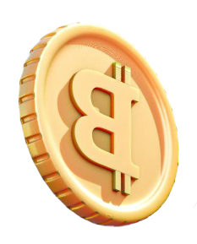
TRADER BEHAVIOUR INSIGHT
MADE BY- Anjali Singh

Slide 2
TABLE OF CONTENTS
01
OBJECTIVE
02
METHODOLOGY
03
INSIGHTS
04
VISUALISATION

Slide 3
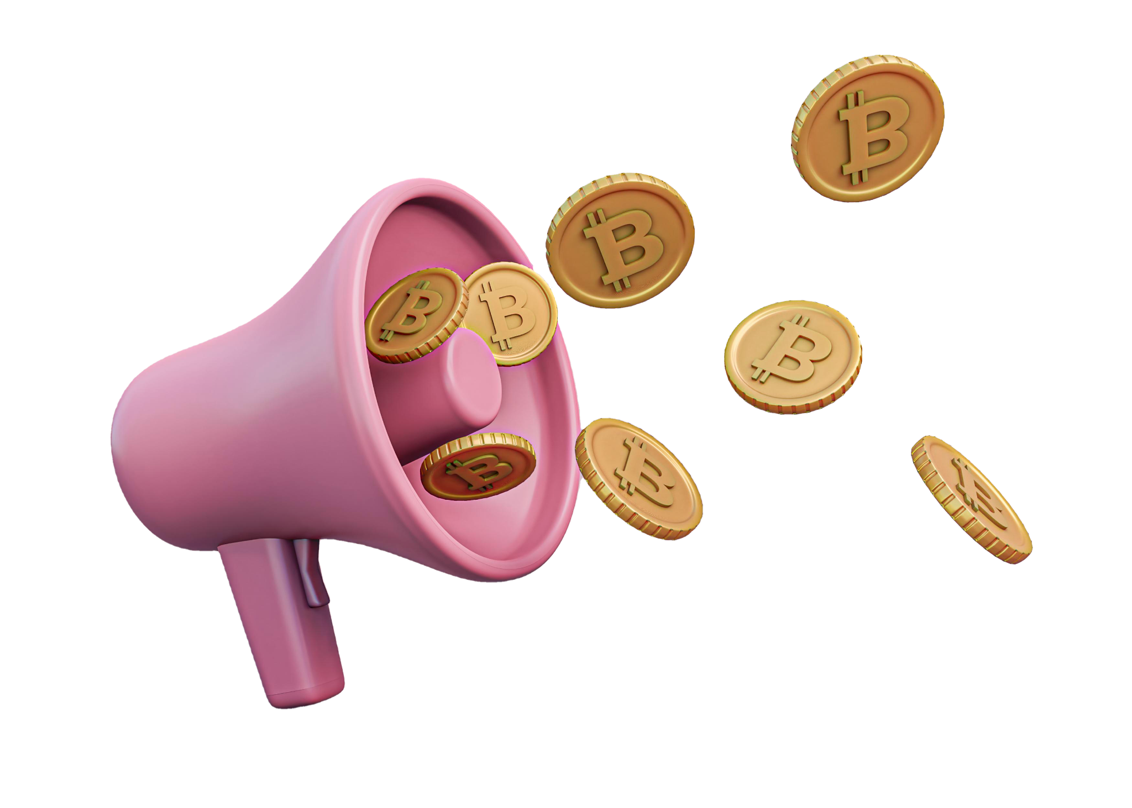
OBJECTIVE
To explore and analyze the relationship between trader performance and market sentiment.
Uncover hidden patterns and deliver insights that can drive smarter trading strategies.
The analysis uses two datasets: "Historical Trader Data from Hyperliquid" and the "Bitcoin Market Sentiment Dataset

Slide 4
Methodology
Data Integration: The two datasets were merged on a daily basis to correlate trading activity with the prevailing market sentiment (Fear or Greed).
Metric Calculation: Trader performance was quantified using metrics such as Return on Investment (ROI), Closed Profit and Loss (PnL), and risk-adjusted metrics like the Sharpe Ratio.
Exploratory Analysis: Data was analyzed to find trends in trading volume, trade size, and trader behavior across different sentiment regimes.

Slide 5

INSIGHTS

Slide 6
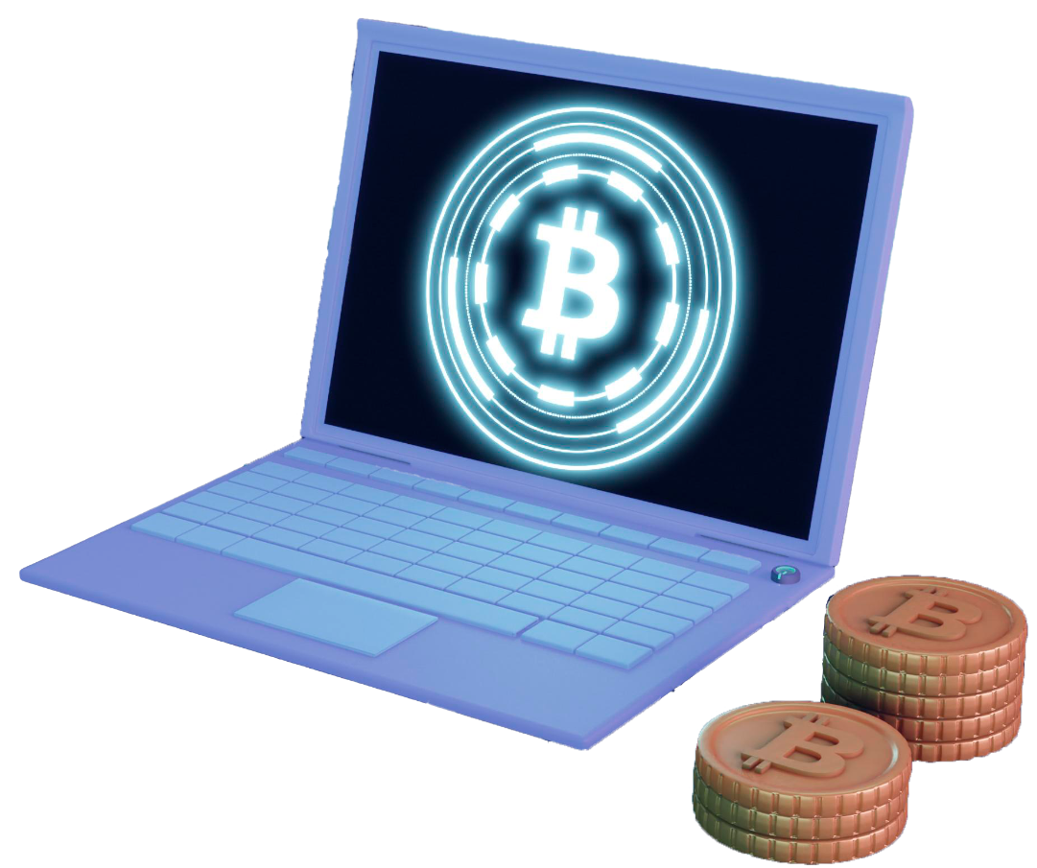
Key Findings: Behavior & Volume
Trading Volume Correlates with Greed: There is a strong positive correlation between trading volume and market sentiment. Trading volume increases significantly during "Greed" periods.
Average Trade Size:
Greed: Traders show more aggressive behavior, with a significantly larger average trade size.
Fear: Traders adopt a more cautious approach, reducing their exposure and making smaller trades.

Slide 7
Key Findings: Performance & Volatility
Higher Returns in Greed: Traders achieve a higher average ROI during "Greed" periods, aligning with the increased risk-taking in bullish markets.
Increased Volatility: PnL volatility is highest during "Greed" periods. While potential for higher returns exists, so does the risk of significant losses.
Top Trader Resilience: Top-performing traders are not immune to these patterns, but are distinguished by their ability to manage risk and maintain a positive win rate across all market conditions.

Slide 8
Strategic Insights
Sentiment-Aware Strategy: Trading strategies should be dynamic and adapt to market sentiment.
Risk Management: Implement stricter risk management protocols (e.g., tighter stop-losses) during "Greed" periods to protect against increased volatility.
Focused Trading: The analysis on top traders suggests that sustained success comes from consistent risk management and discipline, not just from chasing high-return periods.

Slide 9

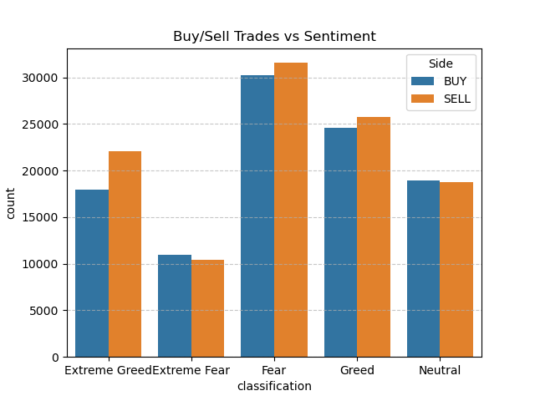
VISUALISATION
Fear drives the most trading activity, showing markets are most reactive when sentiment is negative.
Extreme Greed → More selling than buying, indicating profit-taking after strong rallies

Slide 10
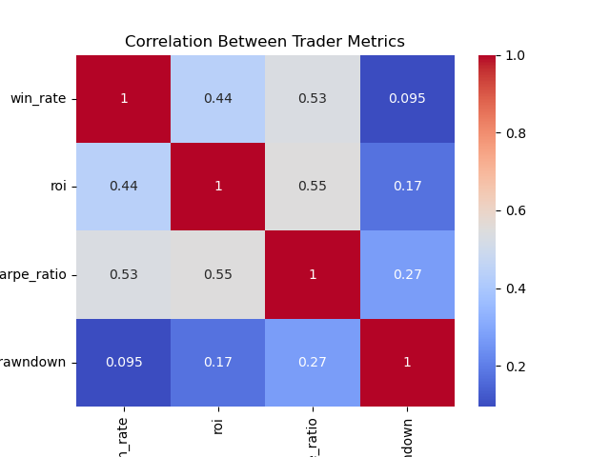
Win Rate and ROI (0.44): There is a moderate positive correlation, suggesting that a higher win rate generally corresponds to a higher return on investment.
ROI and Sharpe Ratio (0.55): There is a moderate positive correlation, implying that higher returns often come with better risk-adjusted returns.
Sharpe Ratio and Drawdown (0.27): There is a weak positive correlation, suggesting a minor link between a higher Sharpe Ratio and larger drawdowns

Slide 11
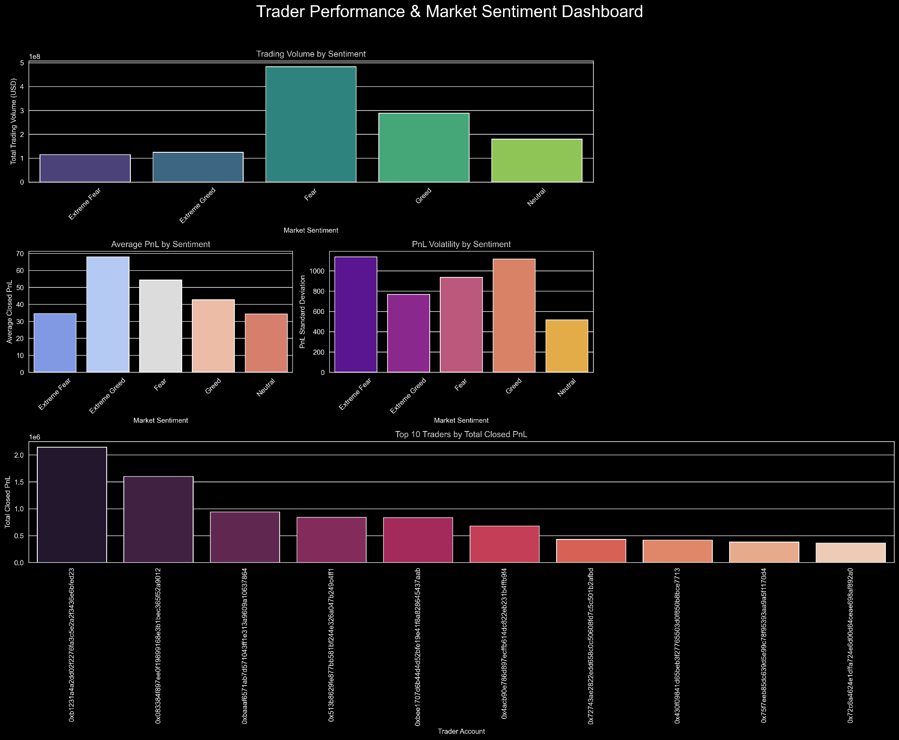

Slide 12
SWOT ANALYSIS
Strengths
Weakness
Opportunity
Threats
S
W
O
T
Comprehensive metrics: The use of multiple metrics (ROI, PnL, Sharpe Ratio) provides a holistic view of performance.
External factors: The analysis does not account for all external factors (e.g., news events, macroeconomic shifts) that influence the market.
Customization: The framework can be applied to other assets or trading communities to generate more tailored insights.
A fundamental shift in market dynamics or trader psychology could invalidate the current finding

Slide 13
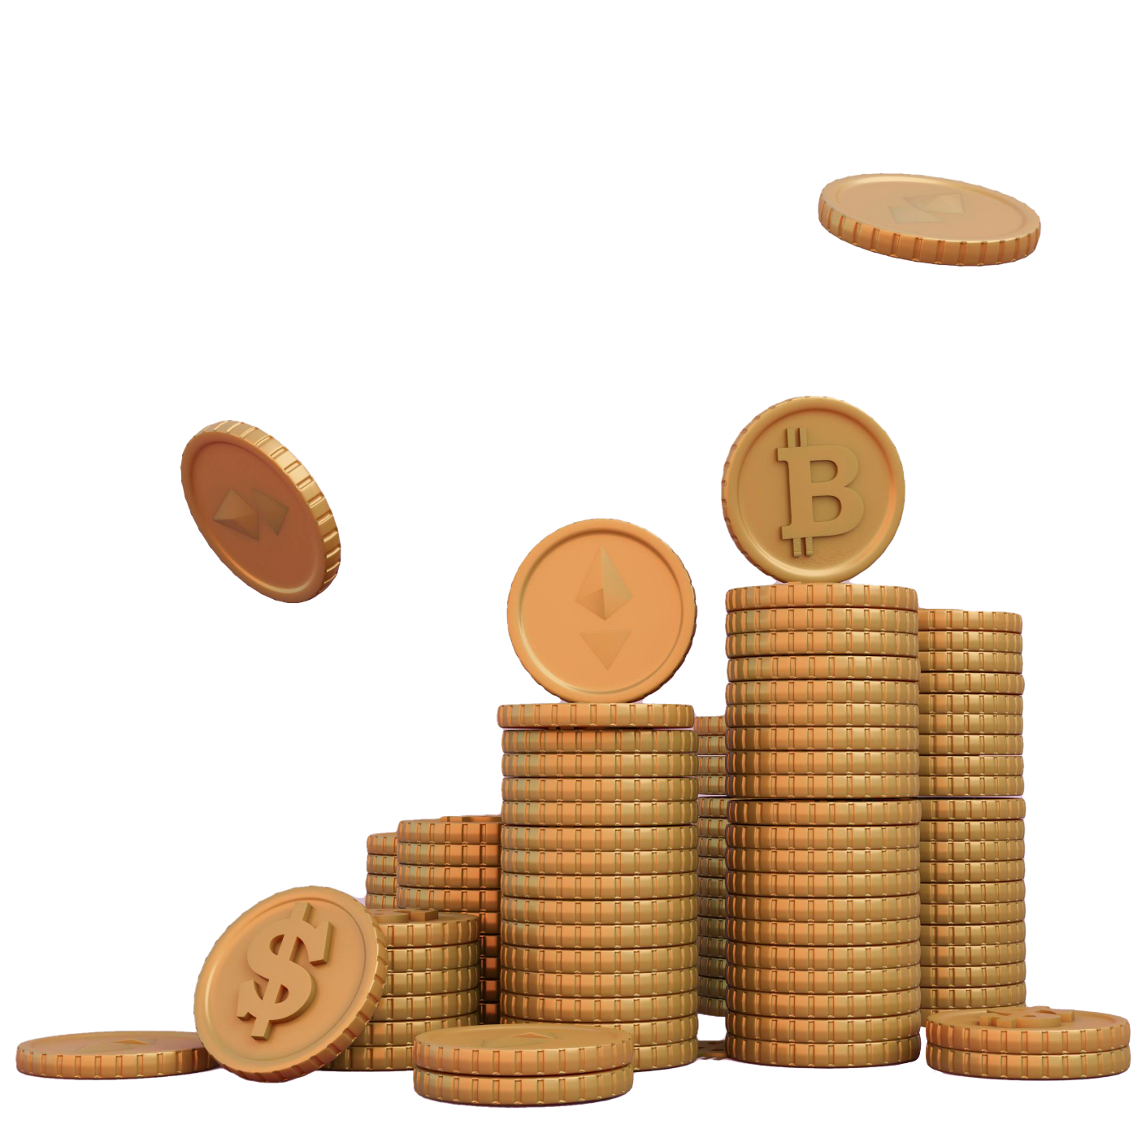
CONCLUSION
“It provides a clear, data-driven understanding of the relationship between market sentiment and trader performance. By incorporating sentiment as a core component of trading strategies, we can make more informed decisions, mitigate risk, and potentially improve long-term profitability

Slide 14
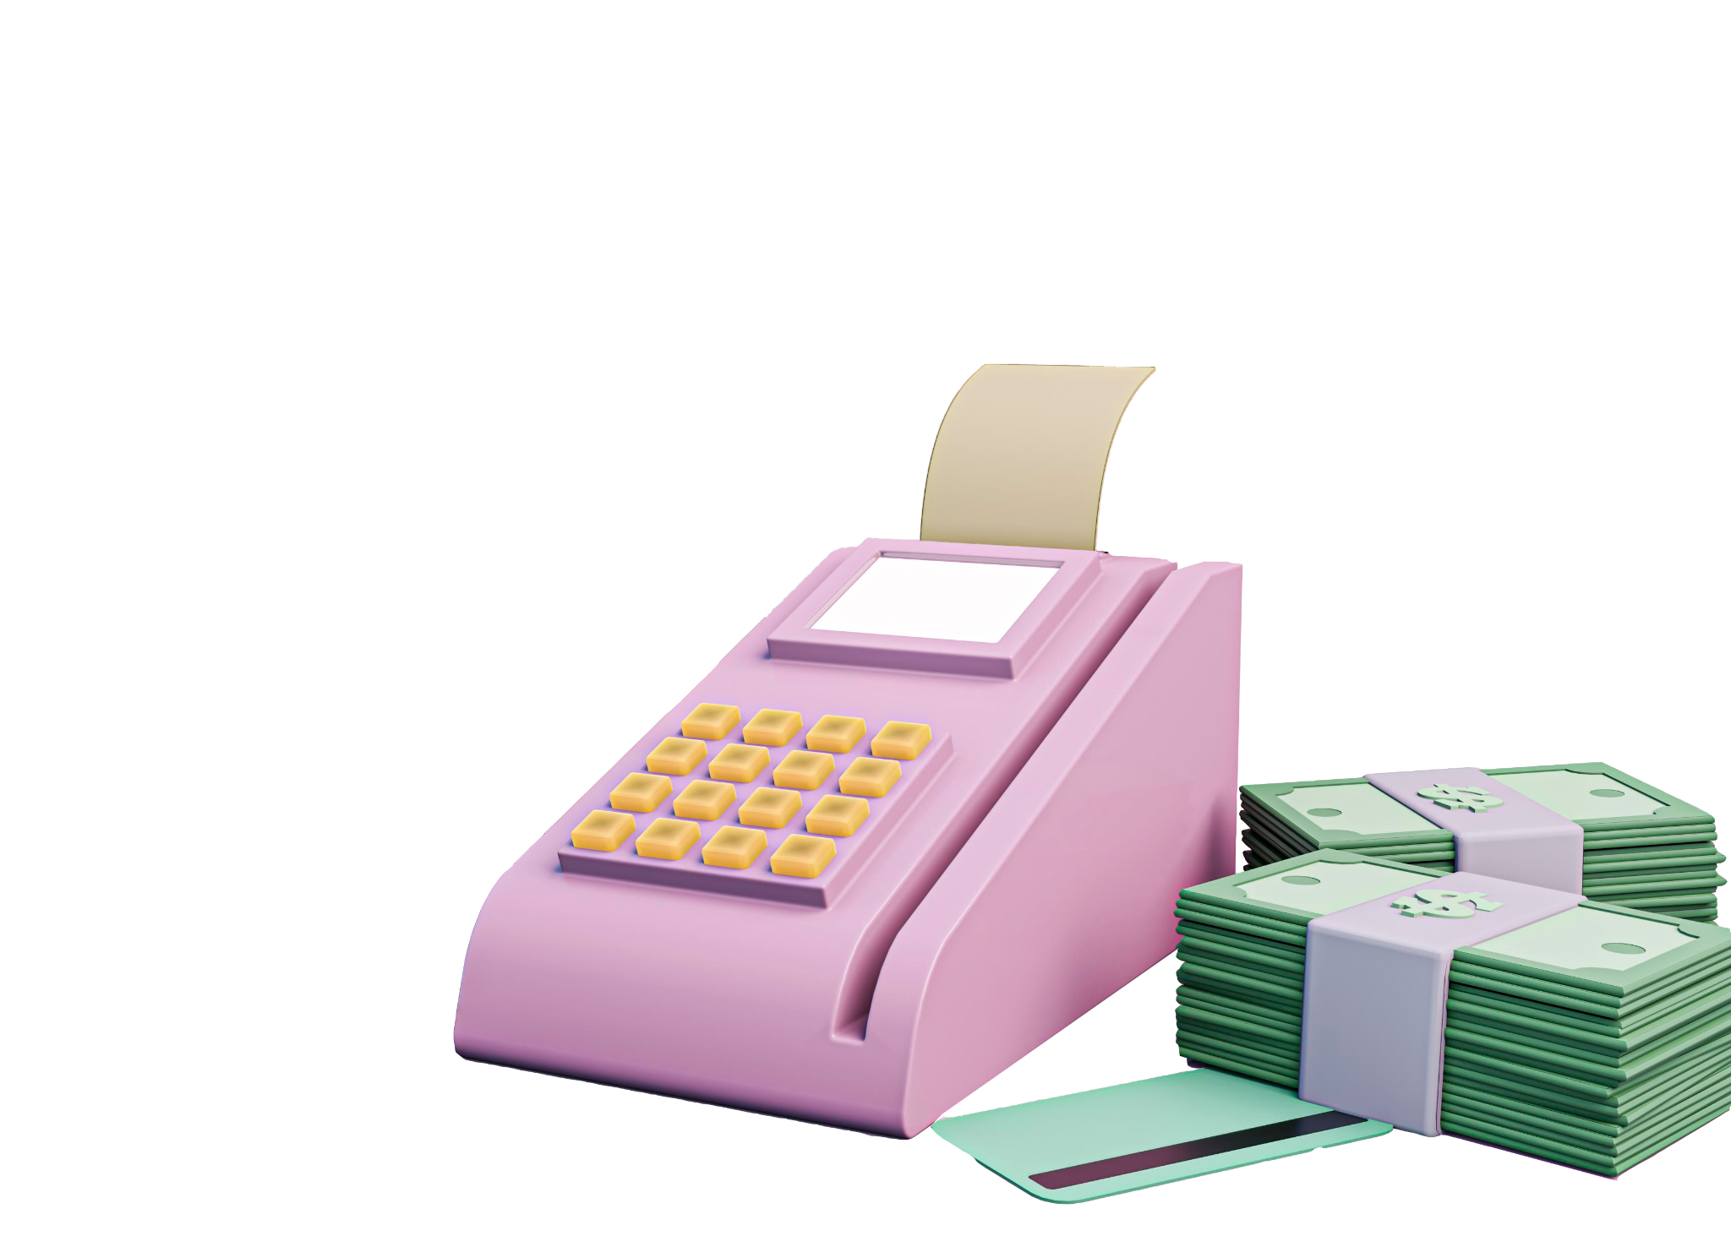
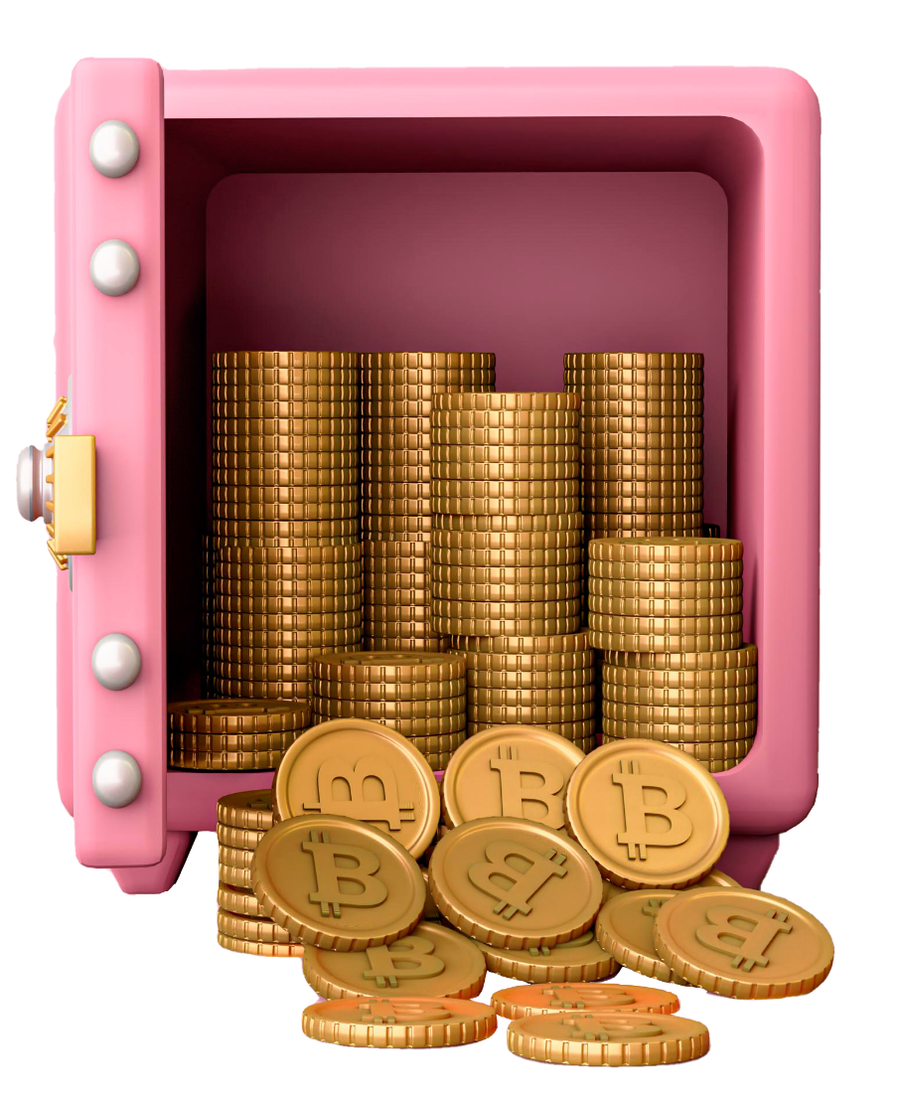
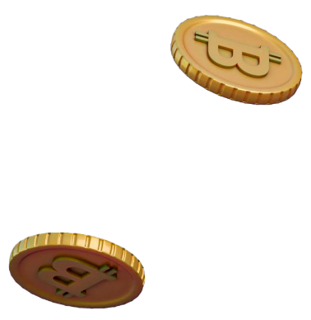
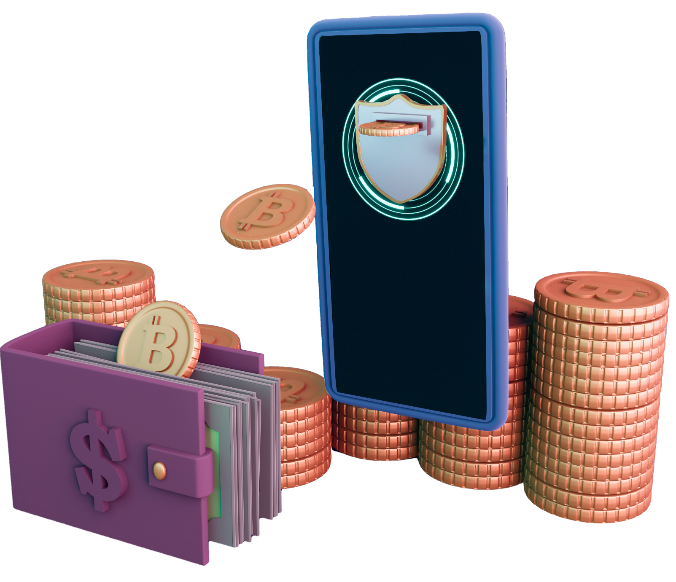
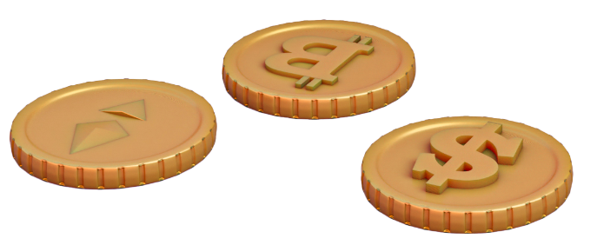
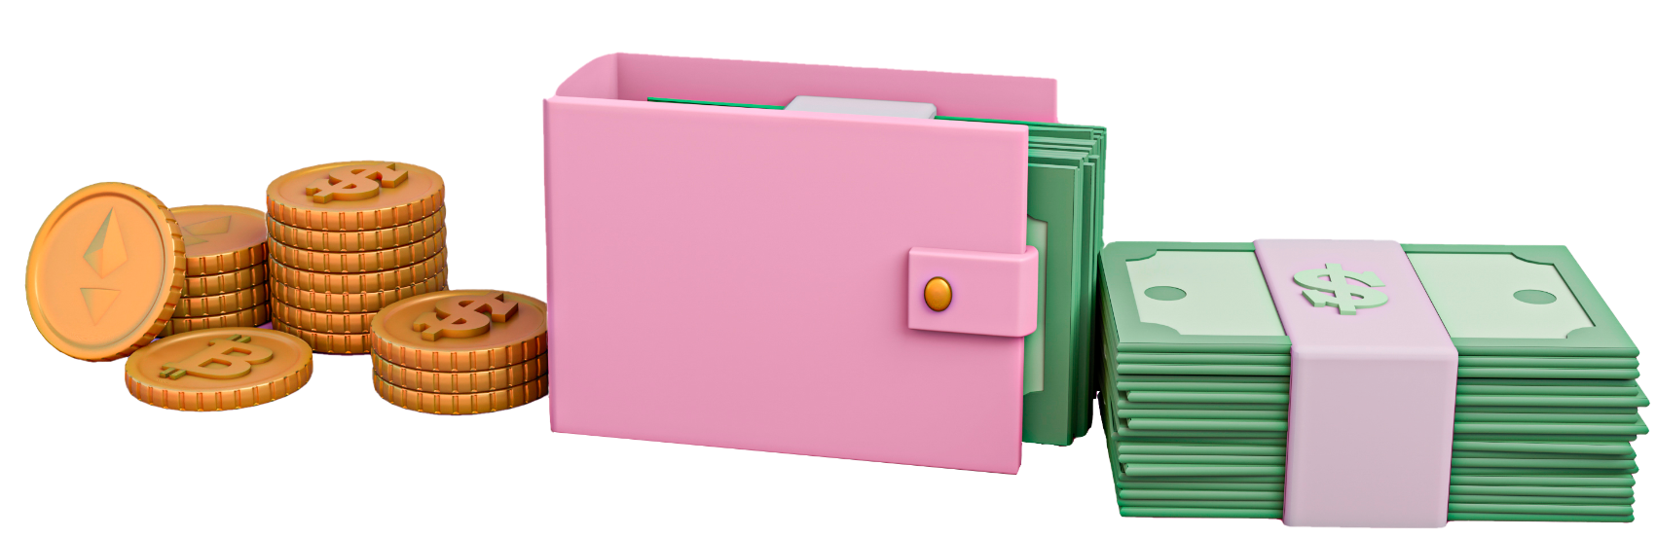
THANK YOU

